Slide 1
CS 3006 Parallel and Distributed Computing Lecture 23
Danyal Farhat
FAST School of Computing
NUCES Lahore

Slide 2
Collective Communication and Computation Operations

Slide 3
Outline
Collective Communication and Computation Operations
Barrier Synchronization Operation
The One-to-All Broadcast
The All-to-One Reduction Operation
MPI_MAXLOC and MPI_MINLOC
The All-Reduce Operation
Prefix (Scan) Operation
Exclusive-Prefix (Exscan) Operation

Slide 4
Outline (Cont.)
Collective Communication and Computation Operations
MPI_Gather and its Variants
MPI_Gather
Gatherv
Gatherv (Displs Calculation Example)
MPI_Allgather
MPI_Allgatherv
MPI_Scatter
MPI_Scatter
MPI_Scatterv
MPI_AlltoAll
Groups and Communicators

Slide 5
Collective Communication and Computation Operations
MPI provides its own optimized implementations for most of the collective operations that we performed in CH#4
These operations are called collective as all the processes must have a call to collective functions
Every collective operation take a communicator (such as MPI_COMM_WORLD) as argument
All the processes within that communicator must have a corresponding call to the operation

Slide 6
Collective Communication and Computation Operations (Cont.)
Barrier Synchronization Operation:
The barrier synchronization operation is performed in MPI using:
int MPI_Barrier(MPI_Comm comm)
The call to the MPI_barrier returns only all the processes in the group have called this function
Implicit barriers at collective communication operations.
The One-to-All Broadcast:
int MPI_Bcast(void *buf, int count, MPI_Datatype datatype, int source, MPI_Comm comm)
Buffer of the source process is copied to the buffers of other processes

Slide 7
Collective Communication and Computation Operations (Cont.)
The All-to-One Reduction Operation:
Dual of one-to-all broadcast
Every process including target provides sendbuf for its value that is to be used for the reduction
After the reduction, reduced value is stored in recvbuf of target process
Every process must also provide recvbuf, though it may not be target of the reduction
int MPI_Reduce(void *sendbuf, void *recvbuf, int count, MPI_Datatype datatype, MPI_Op op, int target, MPI_Comm comm)
Here MPI_Op is MPI defined set of operations for reduction

Slide 8
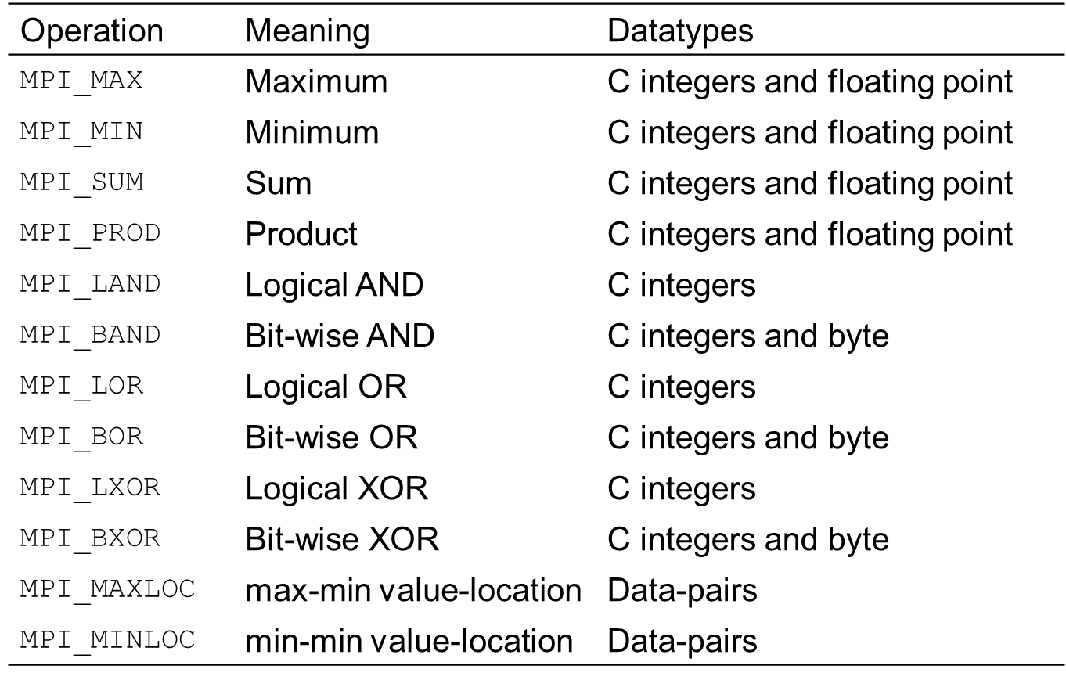
Collective Communication and Computation Operations (Cont.)
The all-to-one reduction operation

Slide 9
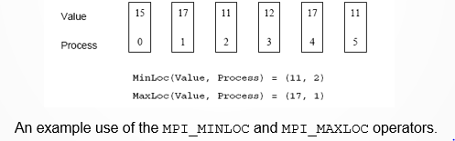
Collective Communication and Computation Operations (Cont.)
MPI_MAXLOC and MPI_MINLOC:
The operation MPI_MAXLOC combines pairs of values (vi, li) and returns the pair (v, l) such that v is the maximum among all vi 's and l is the corresponding li (if there are more than one, it is the smallest among all these li 's)
MPI_MINLOC does the same, except for minimum value of vi

Slide 10
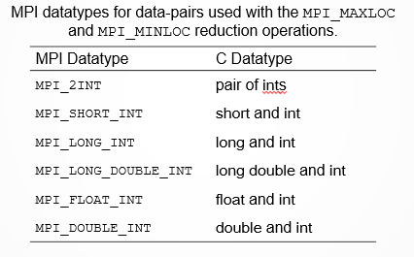
Collective Communication and Computation Operations (Cont.)
MPI_MAXLOC and MPI_MINLOC:

Slide 11
Collective Communication and Computation Operations (Cont.)
The All-Reduce Operation:
MPI_AllReduce is used when the result of the reduction operation is needed by all processes
Equal to All-to-one reduction followed by one-to-all broadcast
int MPI_Allreduce(void *sendbuf, void *recvbuf, int count, MPI_Datatype datatype, MPI_Op op,MPI_Comm comm)
After Allreduce operation, recvbuf of all the processes contain reduced value
Note: No target for reduction is given

Slide 12
Collective Communication and Computation Operations (Cont.)
Prefix (Scan) Operation:
Recall 4.3-for prefix-sum: After the operation, every process has sum of the buffers of the previous processes and its own
MPI_Scan() is MPI primitive for the prefix operations
All the operators that can be used for reduction can also be used for the scan operation
If buffer is an array of elements, then recvbuf is also an array containing element-wise prefix at each position.
int MPI_Scan(void *sendbuf, void *recvbuf, int count, MPI_Datatype datatype, MPI_Op op, MPI_Comm comm)

Slide 13
Collective Communication and Computation Operations (Cont.)
Exclusive-Prefix (Exscan) Operation:
Exclusive-prefix-sum: After the operation, every process has sum of the buffers of the previous processes excluding its own
MPI_Exscan() is MPI primitive for the exclusive-prefix operations
The recvbuf of first process is remains unchanged as there is no process before it
Some MPI distributions place identity value for the given associative operator
0 for sum, -infinity for Max, infinity for Min, 1 for multiplication, and so on
int MPI_Exscan(void *sendbuf, void *recvbuf, int count, MPI_Datatype datatype, MPI_Op op, MPI_Comm comm)

Slide 14
Collective Communication and Computation Operations (Cont.)
MPI_Gather and its Variants:
Recall section 4.4: After the Gather operation, a single target process accumulates[concatenates] buffers of all the other processes without any reduction operator
Each process sends element(s) in its sendbuf to the target process
Total number of elements to be sent by each process must be same
This number is specified in sendcount and is equal to recvcount.
int MPI_Gather(void *sendbuf, int sendcount,
MPI_Datatype senddatatype, void *recvbuf,
int recvcount, MPI_Datatype recvdatatype,
int target, MPI_Comm comm)

Slide 15
Collective Communication and Computation Operations (Cont.)
MPI_Gather and its Variants:
Gatherv:
Each process can have different message length
Recvcounts[i] = Total elements to be received by ith processing node
Displs[i]= starting index in recvbuf to store message received from ith process
int MPI_Gatherv (void *sendbuf, int sendcount, MPI_Datatype senddatatype, void *recvbuf, int *recvcounts,int *displs, MPI_Datatype recvdatatype,int target, MPI_Comm comm)
Notes:
Why MPI does not calculate Displacement vector by itself?
You may want to store data at different array indices.

Slide 16
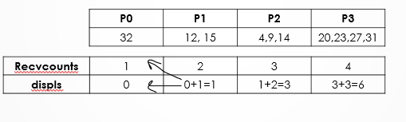
Collective Communication and Computation Operations (Cont.)
MPI_Gather and its Variants:
Gatherv (Displs Calculation Example):
Let each process have elements one more than their rank
Then calculation of displs[] at target is calculated as:

Slide 17
Collective Communication and Computation Operations (Cont.)
MPI_Gather and its Variants:
MPI_Allgather:
Same as All-to-All broadcast described in section 4.2
Every process serve as target for the gather
int MPI_Allgather(void *sendbuf, int sendcount, MPI_Datatype senddatatype, void *recvbuf, int recvcount, MPI_Datatype recvdatatype, MPI_Comm comm)
Note: No target for gather
Unlike MPI_Gather, it gathers sendbufs of all the processes in recvbufs of all the processes
Notes:
Send counts must be same over all the processes (and also be equal to receive count)

Slide 18
Collective Communication and Computation Operations (Cont.)
MPI_Gather and its Variants:
MPI_Allgatherv:
int MPI_Allgatherv(void *sendbuf, int sendcount, MPI_Datatype senddatatype, void *recvbuf, int *recvcounts, int *displs, MPI_Datatype recvdatatype, MPI_Comm comm)
Here every process will have to supply the valid calculated arrays of recvcounts and displs
Furthermore, it is also necessary for all the processors to provide a recvbuf [an array] of sufficient size to store all the elements of all the processes

Slide 19

Collective Communication and Computation Operations (Cont.)
MPI_Scatter:
Scatters data stored in sendbuf of source process between all the processes as discussed in ch#4
int MPI_Scatter(void *s, int sendcount, MPI_Datatype senddatatype, void *recvbuf, int recvcount, MPI_Datatype recvdatatype, int source, MPI_Comm comm)
Sendcount and recvcount should be the same and represent total elements to be given to each process

Slide 20
Collective Communication and Computation Operations (Cont.)
MPI_Scatterv:
Here sendcounts is an array of P size such that its ith index contains number of elements to be sent to ith process
displs[i] indicates the index in sendbuf from which sendcounts[i] values are to be sent to ith process
int MPI_Scatterv(void *sendbuf, int *sendcounts, int *displs, MPI_Datatype senddatatype, void *recvbuf, int recvcount, MPI_Datatype recvdatatype, int source, MPI_Comm comm)
Values of sendbuf and sendcounts at all processes except the source are ignored but, you have to provide pointers though pointing to nothing
Every process will have to calculate its own recvcount

Slide 21

Collective Communication and Computation Operations (Cont.)
MPI_Scatterv (Cont.):
Example program: scatterv.c
Challenge: Write a program that scatters even rows of a 2P X P array to P processes. Assume that we are using 1d array to simulate 2D data.
Notes:
Why MPI does not calculate SendDisplacement vector by itself?
So that a programmer can send overlapping data by manipulating displs vector

Slide 22
Collective Communication and Computation Operations (Cont.)
MPI_AlltoAll:
This routine is used to perform o(aka total exchange) communication in CH#4.peration known as alltoall personalized
Each process has P messages, one for each process
Parallel matrix transpose operation
int MPI_Alltoall(void *sendbuf, int sendcount,MPI_Datatype senddatatype, void *recvbuf,int recvcount, MPI_Datatype recvdatatype,MPI_Comm comm)
Here sendbuf is of size p*message size for each process
Size of receive buffer is equal to sendbuf
Sendcount and recvcount have same integer value representing elements to be sent to each process and elements to be received from each process, respectively
Read and implement vector variant for alltoall personalized communication

Slide 23
Collective Communication and Computation Operations (Cont.)
Groups and Communicators:
In many parallel algorithms, communication operations need to be restricted to certain subsets of processes
MPI provides mechanisms for partitioning the group of processes that belong to a communicator into subgroups each corresponding to a different communicator
The simplest such mechanism is:
int MPI_Comm_split(MPI_Comm comm, int color, int key, MPI_Comm *newcomm)
This operation groups processors by color and sorts resulting groups on the key (i.e., highest key -> highest new_rank).

Slide 24
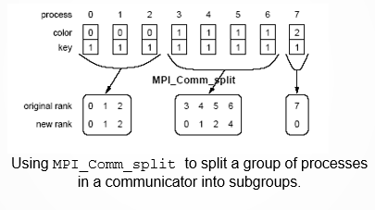
Collective Communication and Computation Operations (Cont.)
Groups and Communicators:

Slide 25
Summary
Collective Communication and Computation Operations
Provides own optimized implementations for most of collective operations
Barrier Synchronization Operation
int MPI_Barrier(MPI_Comm comm)
The One-to-All Broadcast
int MPI_Bcast(void *buf, int count, MPI_Datatype datatype, int source, MPI_Comm comm)
The All-to-One Reduction Operation
int MPI_Reduce(void *sendbuf, void *recvbuf, int count, MPI_Datatype datatype, MPI_Op op, int target, MPI_Comm comm)
MPI_MAXLOC and MPI_MINLOC

Slide 26
Summary (Cont.)
The All-Reduce Operation
int MPI_Allreduce(void *sendbuf, void *recvbuf, int count, MPI_Datatype datatype, MPI_Op op,MPI_Comm comm)
Prefix (Scan) Operation
int MPI_Scan(void *sendbuf, void *recvbuf, int count, MPI_Datatype datatype, MPI_Op op, MPI_Comm comm)
Exclusive-Prefix (Exscan) Operation
int MPI_Exscan(void *sendbuf, void *recvbuf, int count, MPI_Datatype datatype, MPI_Op op, MPI_Comm comm)

Slide 27
Summary (Cont.)
MPI_Gather and its Variants
MPI_Gather
int MPI_Gather(void *sendbuf, int sendcount, MPI_Datatype senddatatype, void *recvbuf, int recvcount, MPI_Datatype recvdatatype, int target, MPI_Comm comm)
Gatherv
int MPI_Gatherv (void *sendbuf, int sendcount, MPI_Datatype senddatatype, void *recvbuf, int *recvcounts,int *displs, MPI_Datatype recvdatatype, int target, MPI_Comm comm)
Gatherv (Displs Calculation Example)

Slide 28
Summary (Cont.)
MPI_Gather and its Variants (Cont.)
MPI_Allgather
int MPI_Allgather(void *sendbuf, int sendcount, MPI_Datatype senddatatype, void *recvbuf, int recvcount, MPI_Datatype recvdatatype, MPI_Comm comm)
MPI_Allgatherv
int MPI_Allgatherv(void *sendbuf, int sendcount, MPI_Datatype senddatatype, void *recvbuf, int *recvcounts, int *displs, MPI_Datatype recvdatatype, MPI_Comm comm)

Slide 29
Summary (Cont.)
MPI_Scatter and its Variants
MPI_Scatter
int MPI_Scatter(void *s, int sendcount, MPI_Datatype senddatatype, void *recvbuf, int recvcount, MPI_Datatype recvdatatype, int source, MPI_Comm comm)
MPI_Scatterv
int MPI_Scatterv(void *sendbuf, int *sendcounts, int *displs, MPI_Datatype senddatatype, void *recvbuf, int recvcount, MPI_Datatype recvdatatype, int source, MPI_Comm comm)

Slide 30
Summary (Cont.)
MPI_AlltoAll
int MPI_Alltoall(void *sendbuf, int sendcount,MPI_Datatype senddatatype, void *recvbuf,int recvcount, MPI_Datatype recvdatatype,MPI_Comm comm)
Groups and Communicators
int MPI_Comm_split(MPI_Comm comm, int color, int key, MPI_Comm *newcomm)

Slide 31
Additional Resources
Introduction to Parallel Computing by Ananth Grama and Anshul Gupta
Chapter 6: Programming Using Message Passing Paradigm

Slide 32
Questions?

